Slide 1




Create an
app
Writing. Storyboard

Slide 2
contents
1
2
TITLE
INTRODUCTION
3
4
STORYBOARD DESIGN
CONCLUSION

Slide 3


TITLE
MindWave
A Multimedia App to Improve Focus and Well-being

Slide 4

introduction
MindWave is a multimedia application designed to help users improve their concentration and reduce stress. The app combines relaxing sounds, short videos, and simple interactive activities to create a calm and positive experience.
Its main purpose is to support mental well-being in an easy and accessible way.
MindWave is mainly aimed at students and people who spend long hours studying or working in front of a screen.

Slide 5
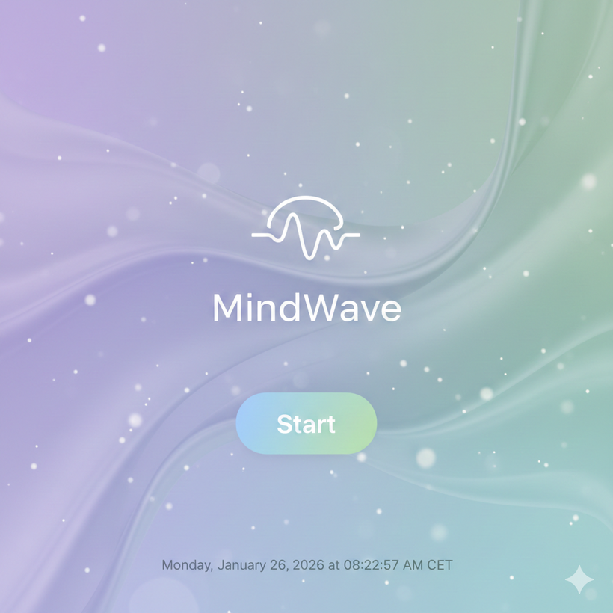
storyboard design (I)
Screen 1: Home Screen
Screen description:
The user sees the MindWave logo and a “Start” button. The background shows soft colors and gentle animations to create a relaxing atmosphere.
Objective: The user can start the application and access the main menu.

Slide 6
storyboard design (I)
Screen 1: Home Screen
Screen description:
The user sees the MindWave logo and a “Start” button. The background shows soft colors and gentle animations to create a relaxing atmosphere.
Objective: The user can start the application and access the main menu.

Slide 7
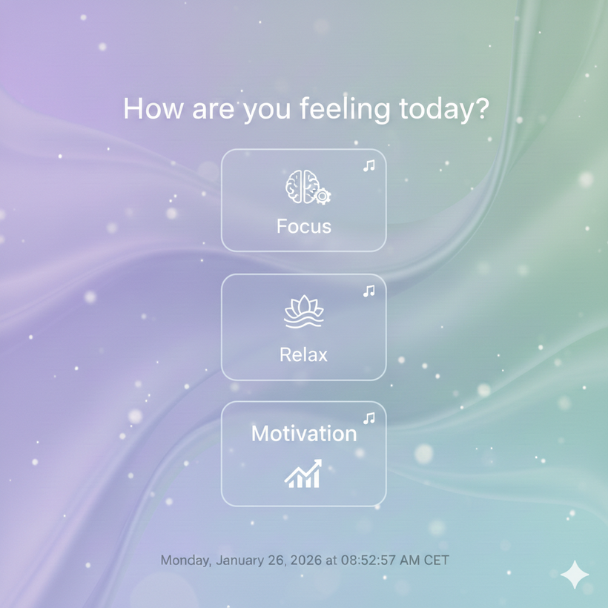
storyboard design (II)
Screen 2: Mood Selection
Screen description:
Several options appear on the screen, such as “Focus”, “Relax”, and “Motivation”, each one with an icon and background music.
Objective: The user chooses their current mood or what they want to improve.

Slide 8
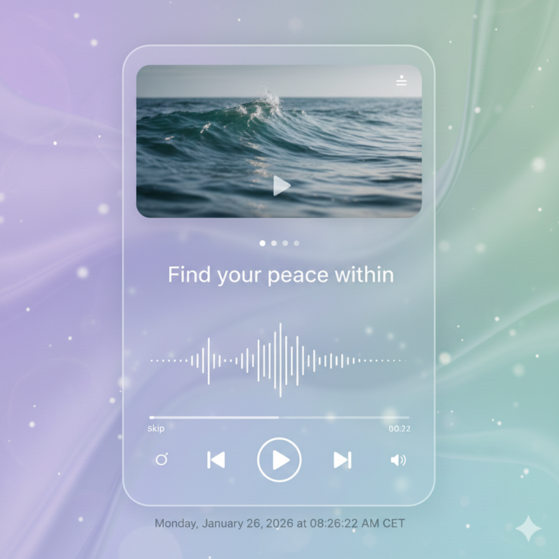
storyboard design (III)
Screen 3: Multimedia Content
Screen description:
A media player shows short videos, calming sounds, and positive messages. Simple controls allow the user to play, pause, or change the content.
Objective: The user can enjoy the multimedia content and adapt it to their needs.

Slide 9

storyboard design (IV)
Screen 4: Interactive Activity
Screen description:
The app presents easy activities like guided breathing exercises or small concentration challenges.
Objective: The user actively participates to relax and improve their focus.

Slide 10

Conclusion
In conclusion, MindWave is a simple and user-friendly application that combines multimedia and interaction to improve mental well-being. Its main advantages are its intuitive design and its focus on relaxation and concentration. With MindWave, users can take care of their mind while studying or working in a balanced way.

